Slide 1
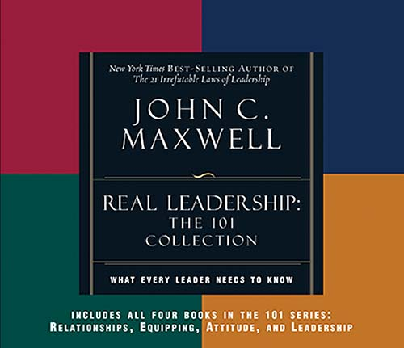
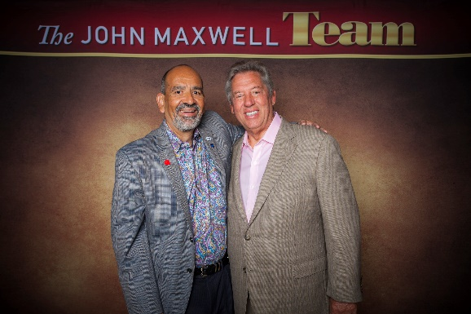
Welcome
Bienvenidos
Memo Vargas

Slide 2
Success
Knowing
Growing
Sowing
Notes:
Success is:
Knowing your purpose in life
Growing to your maximum potential
Sowing seeds that benefit others

Slide 3
Success is…
Relationships
Notes:
In actual studies of leadership it has been proven that the average executive spends three quarters of his working day dealing with people.
Most people can trace their successes and failures to the relationships in their lives.

Slide 4
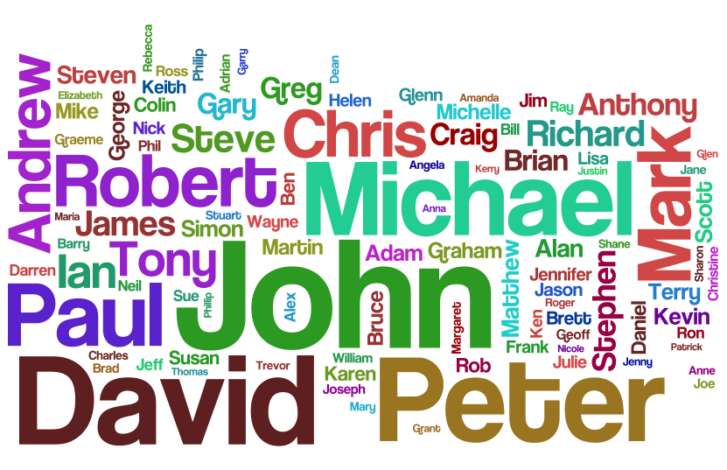
Relationship Rules
Notes:
Love and accept yourself
Put energy into being likable
Remember their names
Focus on their interests
Request the help of others
Add value to people

Slide 5
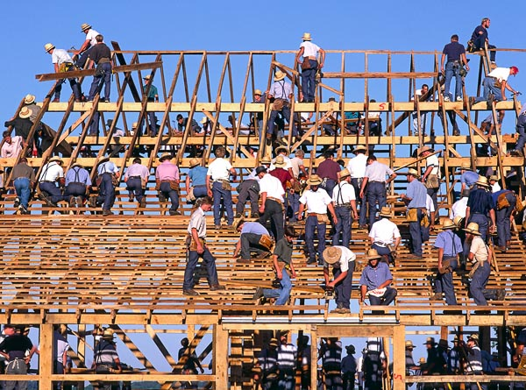
Equipping
Law of Significance – One is too small a number to achieve greatness

Slide 6
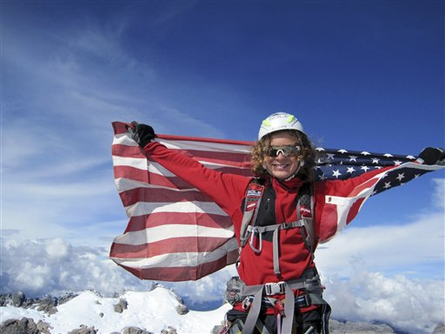
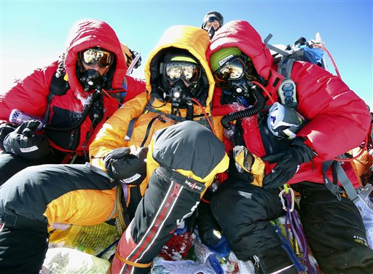
Equipping
Law of Mt.Everest – As the challenge escalates, the need for teamwork elevates
Notes:
In this photo (on right) taken Saturday, May 22, 2010 and released by Team Romero, 13-year-old Jordan Romero, center, poses for photos with his father Paul, left, and stepmother Karen Lundgren on the summit of Mt. Everest, the world's highest peak. Jordan became the youngest climber to reach the top of Mt. Everest, the 29,035-foot (8,850-meter) peak after climbing it from the Chinese side accompanied by a team that included his father, his stepmother and three Sherpa guides. (AP Photo/Team Romero)

Slide 7
Attitude
Notes:
Our attitude is a choice
Our attitude determines our approach to life
Our attitude can turn our problems into blessings

Slide 8
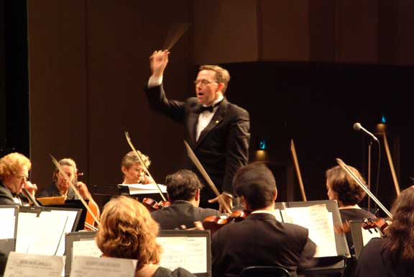
Leadership
Law of the Lid – Leadership ability determines a person’s level of effectiveness

Slide 9
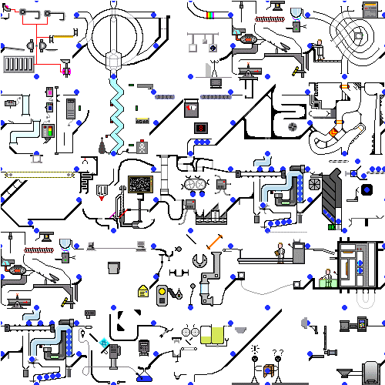
Leadership
Law of Process – Leaders develop daily, not in a day
Notes:
We overestimate the event and underestimate the process. The secret of our success is discovered in our daily agenda

Slide 10
What Leaders Do
Challenge
Inspire
Enable
Model
Encourage
Notes:
Challenge the process
Inspire a shared vision
Enable others to act
Model the way
Encourage the heart

Slide 11
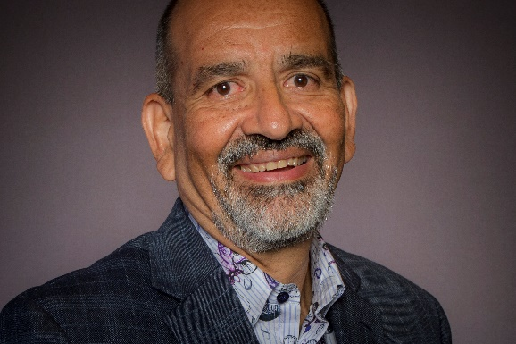
Thank You
Gracias
Memo Vargas

